Slide 1
Bachelor Thesis
The Needle Detection and Reconstruction Based on OCT image with GPU Acceleration
Anh Tuan Pham
LMU

Slide 2
About the thesis :
Recontruction of needle with CAD model
Existing algorithm of Ramona Schneider with Iterative Closest Point
Disadvantage : Execution time, still 2-3 seconds for a top notch processor
Goal : Accelerating the algorithm with GPU Programing (OpenCL)

Slide 3
GPU Programming
Differences comparing with CPU Programming:
  More threads avaible : superior number of cores and work units
  Better for highly parallelized tasks : image processing, computer graphics
  External libraries are not usable
  Requires Kernel code and extra preparation
Implementation
  2 popular implememtations : OpenCL and CUDA
  OpenCL available for GPUs of both Vendors : AMD and NVIDIA
  CUDA only for NVIDIA, however better optimized.

Slide 4
OpenCL Framework
About:
  Developed by Khronos Group as freeware
  Crossplatform, parralel programming for diverse processors, not only GPU
  Using C++ kernel language
  Able to utilize multiple device in a programm
  Standardized Definition between devices

Slide 5
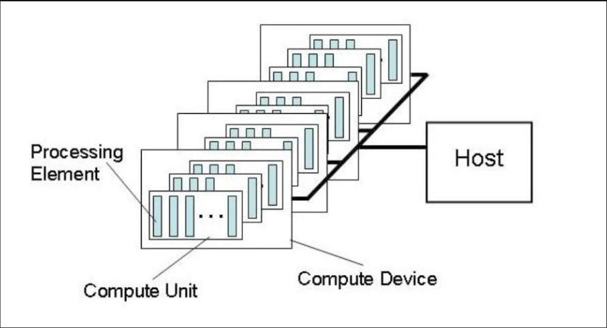
Host and Device Model

Slide 6
Memory Model
Types:
  Private memory
  Local memory
  Global memory
Differences:
  Access speed
  Size of memory available

Slide 7
Workflow
Steps for each iteration (4 iterations)
  Transforming point clouds with matrix
  Finding Correspondences
  Analyzing results
Update after each iteration
  Shift and Angle steps
  Start and End of angle
  Start and End of shift

Slide 8
PLACE HOLDER FOR DIAGRAM

Slide 9
Optimization
Strategy:
  Maximize the number of work units used.
  Synchronize between work units in work group
API:
  Reduce the number of arguments and memory objects
  Reuse memory
  Optimization of local and global work size

Slide 10
Results
Different results for different devices
Second step takes the most time in overall execution → Room for improvement
10-20x faster for targeted devices

Slide 11
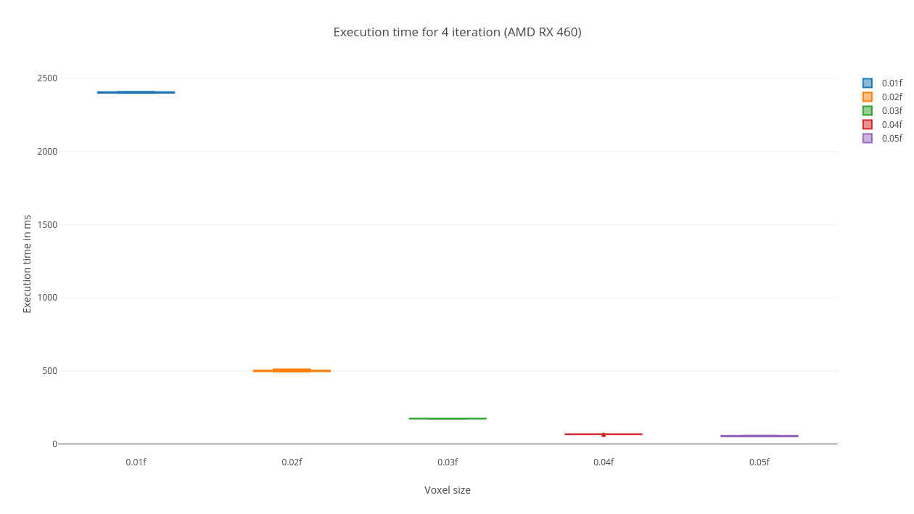

Slide 12
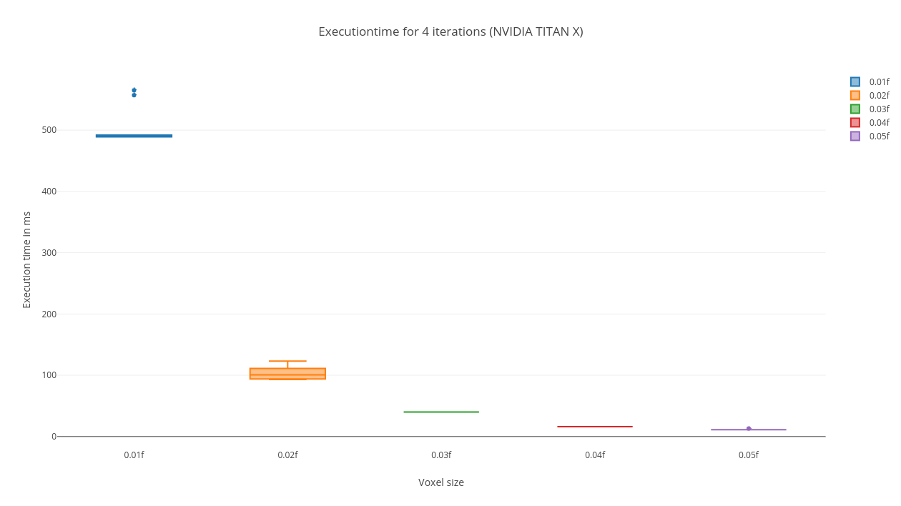

Slide 13
